Slide 1
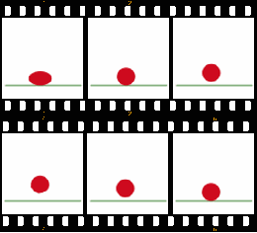
Animation
Creating the Bouncing Ball:
Arcs, Easing, and Squash and Stretch
This work has been released into the public domain by its author, Branko at the English Wikipedia project. This applies worldwide.

Slide 2
Why Create the Bouncing Ball?
The bouncing ball exercise is the starting point for all animators. Unless an animator can make a ball bounce in a believable fashion, it would not be wise to try more complex exercises. All animators should have an example of a bouncing ball somewhere in their portfolio (reel).
This work has been released into the public domain by its author, Branko at the English Wikipedia project. This applies worldwide.

Slide 3
Three Principles of Animation
The bouncing ball covers three of the basic principles of animation:
motion in arcs
slow in/slow out (easing)
squash and stretch
All components are necessary to give the motion the correct look.

Slide 4
Motion in Arcs
The ball falls in an elliptical arc through space. Most objects move in some sort of arc. If the ball was to move in a straight line between the top and bottom points of the bounce, then the action would look very unnatural.

Slide 5
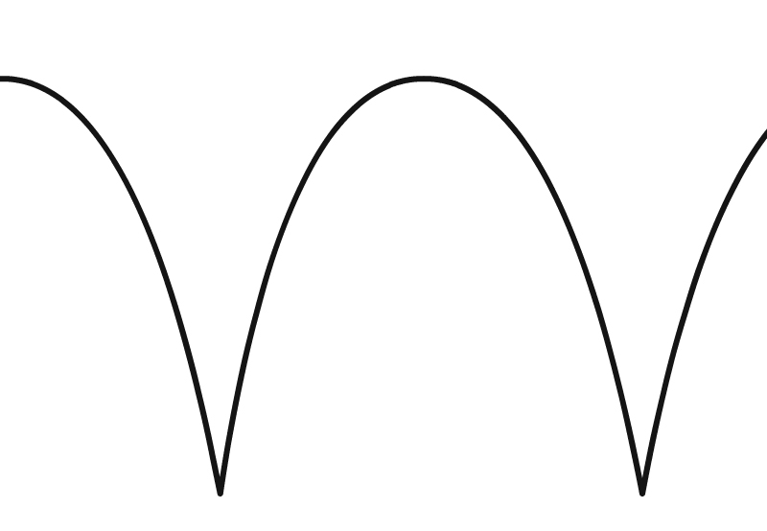
Arched Path for a Bouncing Ball

Slide 6
Linear Motion
When objects move at an even pace, the motion is referred to as linear. When most objects are in motion, they are slowing down or speeding up. A common mistake of animators is to not change this linear motion. Linear motion is not appropriate for a bouncing ball.

Slide 7
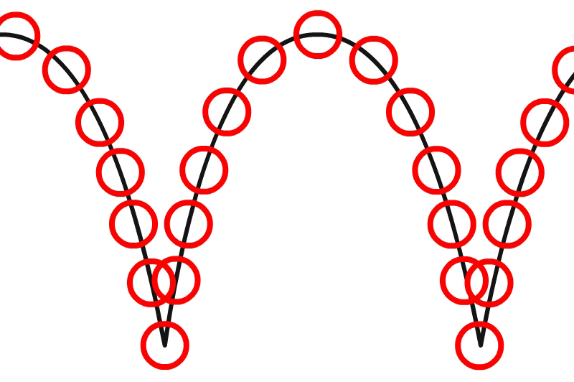
Linear Motion

Slide 8
Slow In / Slow Out (Easing)
As the ball falls it is accelerated by gravity, the gap between each frame grows all the time until the ball hits the ground. As the ball bounces, the ball moves very fast at first, then slows down by gravity at the high point of its bounce. At the high point of the bounce, the ball is weightless. This speeding up and slowing down of the motion is called “easing.”

Slide 9
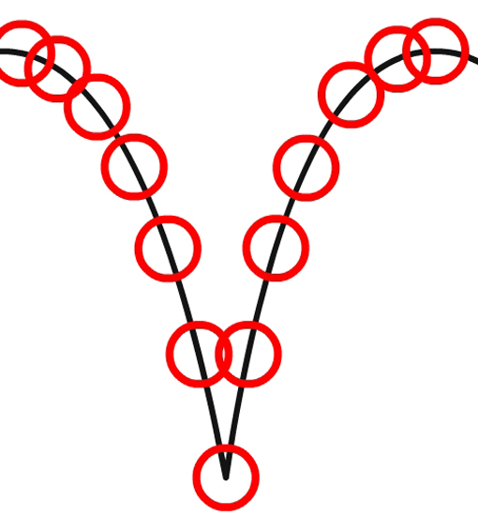
Easing Applied

Slide 10
Squash
When it impacts the ground, it squashes. The volume must remain the same. If an object becomes wider (squashed) it must also become shorter. Squeezing a balloon illustrates the concept of constant volume while squashing and stretching.

Slide 11
Squash at Impact

Slide 12
Stretch
At some point as the ball falls, it stretches. When it impacts the ground, it squashes. When it bounces off the ground, it stretches again. Note how quickly the ball regains its circular shape.

Slide 13
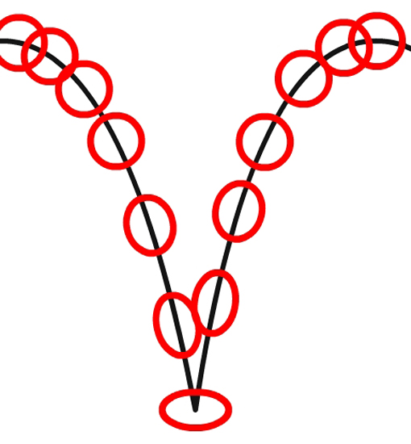
Stretch Before and After Impact

